Slide 1

P peline
The Data
Visualizing and Exploring
© Jennifer Mankoff
The Data Pipeline; HCII; Spring 2014

Slide 2
Goals
After this, you should be able to:
Describe data types and how to transform among them
Draw a stem and leaf plot for a data set
Explain how a box plot works
Recognize common types of distributions and the assumptions that lie behind them
Adapted from http://www.fordham.edu/economics/Vinod/correl-regr.ppt

Slide 3
Preparing for Analysis / Visualization

Slide 4
Goals
Summarizing the Data
Summary Tables
Descriptive statistics
Graphs
Finding Hidden Relationships
Asking specific questions
Correlations
Grouping
[eventually] Making Predictions

Slide 5
Transforming your data: Normalization
Allows different fields to be compared
Avoids undue influence of a column that happens to have large values
Often moves data to 0-1 range
Non-linear transformations (e.g., transforming log-normal data to a normal scale by taking the log)

Slide 6
Transforming your data: Ordinal <-> Numeric
Value Mapping
Convert ordinal values into numbers
Discretization
Convert numbers into ordinal values (binning)
Smooth data
Bin Nominal data into categories

Slide 7
Transforming your data: Calculations
Aggregation of Fields
Calculation of Features

Slide 8
Pros and Cons of Transformation
Notes:
----- Meeting Notes (1/29/15 10:06) -----
move to where it is relevant to the data analysis process instead of here.

Slide 9
Visual Representations of your Data

Slide 10
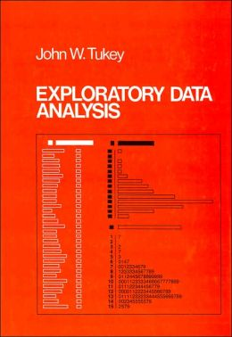
Visual Tool Chest: Stem and Leaf
Tukey’s tool of choice first
Easy to do by hand
Careful design adds value

Slide 11
Exercise: Stem and Leaf of Zip?
Printout of summary .csv file for you (already done half the work here). Look at columns 5/6
40175 x x x
40201 x x x
40224 x x x
37013 x …
Notes:
Have them do an exercise in class

Slide 12
Exercise: Stem and Leaf of Zip?
Alternative: Digit reminder representation (columns 5-8 only here):
400* 33 55 57 68 08 08 19 19
401* 04 08 76 95 75 75 75 19 19 50 50 85 85
* 53 65 70 77 79 01 01 01 24 24 24 27 27 56 56 71 17 95 95
* 90
405* 03 05 11 15
…
Notes:
Have them do an exercise in class

Slide 13
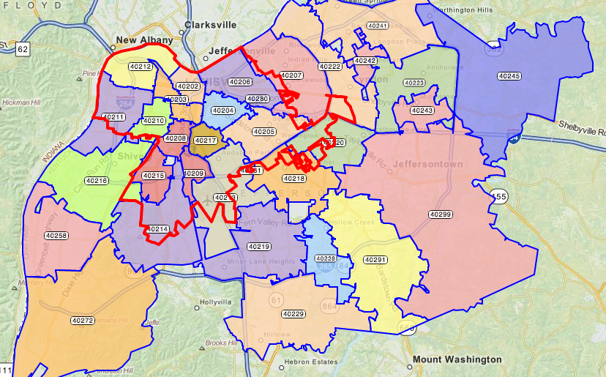
Aside – what do we expect to see?

Slide 14
Exercise: Stem and Leaf of Zip?
What about column 1-4’- data?
402*: 15 15 15 15 15 15 15 15 … 2034 times; 16 … 640 times; …
How could we represent that?
Notes:
- Could represent using 10s or 100s per ‘digit’ (but what do we do about 2 digits in this case? Round to 0?)
- Other ideas?

Slide 15
Exercise: Stem and Leaf of Zip?
What about column 1-4’- data?
402*: 15 15 15 15 15 15 15 15 … 2034 times; 16 … 640 times; …
1000s? (round up?)
402*: 15 15 16 …
Notes:
- Could represent using 10s or 100s per ‘digit’ (but what do we do about 2 digits in this case? Round to 0?)
- Other ideas?

Slide 16
Exercise: Stem and Leaf of Zip?
What about column 1-4’- data?
402*: 15 15 15 15 15 15 15 15 … 2034 times; 16 … 640 times; …
1000s? (round up?)
402*: 15 15 16 …
Counting to 10 (or 100):
. ☐ ☐
. . ☐ ☐
.
. . ☐
. .
. . ☐
Notes:
- Could represent using 10s or 100s per ‘digit’ (but what do we do about 2 digits in this case? Round to 0?)
- Other ideas?

Slide 17
Exercise: Stem and Leaf of Zip?
What about column 1-4’- data?
402*: 15 15 15 15 15 15 15 15 … 2034 times; 16 … 640 times; …
1000s? (round up?)
402*: 15 15 16 …
‘visual’ 100s
402*: 15 ☐☐16☐ 72 ☐ 14 ☐ 19 12 11 58 29 18
10 91 03 99 08 13 18 20 17 28 06 …
. .
. .
. .
. .
. .
. .
. .
. .
. .
. .
.
. .
.
. .
.
.
.
.
.
.
.
.
.
.
.
.
.
.
.
Notes:
Could represent using 10s this way too… or thousands
What do we do when the range is so big?
What do we do about the long tail?

Slide 18
Exercise: Stem and Leaf of Zip?
Now you do it…
What about column 1-4’- data?
402*: 15 15 15 15 15 15 15 15 … 2034 times; 16 … 640 times; …
1000s? (round up?)
402*: 15 15 16 …
‘visual’ 100s
402*: 15 ☐☐16☐ 72 ☐ 14 ☐ 19 12 11 58 29 18
10 91 03 99 08 13 18 20 17 28 06 …
. .
. .
. .
. .
. .
. .
. .
. .
. .
. .
.
. .
.
. .
.
.
.
.
.
.
.
.
.
.
.
.
.
.
.
Notes:
Could represent using 10s this way too… or thousands
What do we do when the range is so big?
What do we do about the long tail?

Slide 19
Wide Range of Uses (e.g.)
 |  | <6mo | 6mo-1y | 1-6 | 7+
 | ☐ | . . | . . | ☒ . . | ☐
Lost Reported Expired | ☒ ☒ ☒ ☒ ☒ ☒ ☒ ☒ ☒ ☒ ☒ ☒ ☒ ☐ | . |  | . | .
Foster | ☒ ☒ ☐ | ☒ ☒ ☒ ☒ ☒ ☒ ☒ ☒ ☒ ☒ ☒ ☒ . | ☒ ☒ . | ☒ ☒ ☒ ☒ ☒ ☒ ☒ ☐ | ☒ ☐
Missing | ☐ . | . . |  |  | . .
Returned to Owner | ☒ ☒ ☒ ☒ ☒ ☒ ☒ ☒ ☒ ☒ ☒ ☒ ☒ ☒ ☒ ☒ ☒ ☒ ☒ ☒ ☒ ☒ ☒ ☒ ☒ ☒ ☒ ☒ ☒ ☒ ☒ ☒ ☒ ☒ ☒ ☒ ☒ . . | ☒ ☒ ☒ ☒ ☒ ☒ | ☒ ☒ ☒ ☒ ☒ ☒ ☒ ☒ ☒ ☒ ☐ |  | ☒ ☒ ☒ ☒ ☒ ☒ ☒ ☒ ☒ ☒ ☒ ☒ ☒ ☒ ☒ ☒ ☒ ☒ ☒ ☒ ☒ ☒ ☒ ☒ ☒ ☒ ☒ ☒ ☐
Disposal | ☒ ☒ ☒ ☒ ☒ ☒☐ | . . |  |  | ☒ ☐
Transferred to Rescue
Found Expired
Adopted
Euthanized
Released in Field
No Show
Died

Slide 20
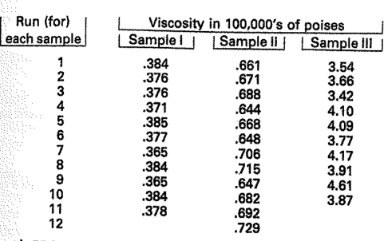
Example of comparison

Slide 21
Benefits of Steam + Leaf
Quick & easy to produce; very flexible
Easy to annotate in all sorts of ways; use for comparison (of different samples); etc
Help to highlight unsymmetric trailing off
Help to highlight popular/unpopular values
About where values are ‘centered’
About how widely values are ‘spread’

Slide 22
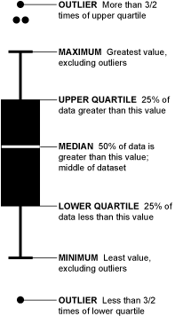
Boxplot (invented by Tukey) [image from flowingdata.com/2008/02/15/how-to-read-and-use-a-box-and-whisker-plot/]
Notes:
Can show certain types of unexpected structure (e.g. variance)
You can also see which way the data sways. For example, if there are more people who eat a lot of burgers than eat a few, the median is going to be higher or the top whisker could be longer than the bottom one. Basically, it gives you a good overview of the data's distribution.
Some variation in how these are assigned…

Slide 23
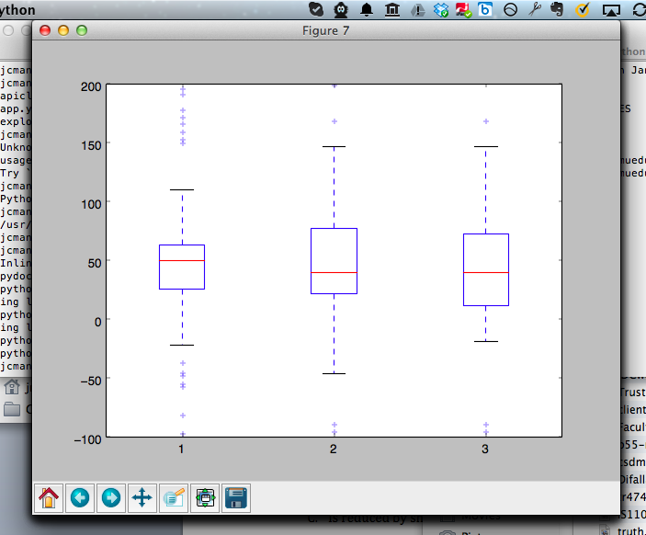
Boxplot [Random Data; 3 times]
Notes:
Boxplots make comparison really easy …
Can also show certain types of unexpected structure (e.g. variance variance)
Created with ‘boxplot-demo.py’
Box is 25%
Line is median
Dots are outliers
Xx update

Slide 24
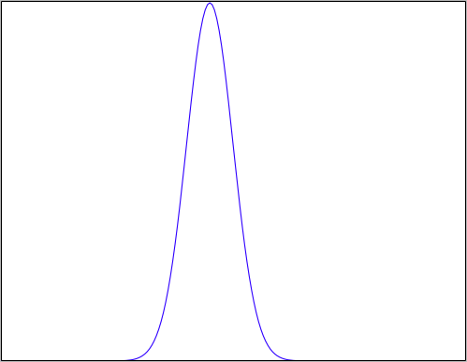
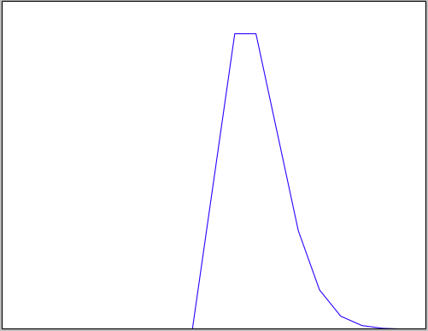
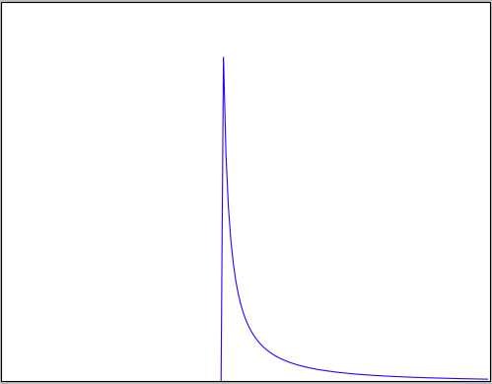
Histograms: Checking a Distribution
Histogram (eyeball)
Example distributions:
Normal
Poisson
Log Normal
Notes:
Example

Slide 25
What your distribution implies: Normal Distribution
Properties:
No long tail (bell shaped)
Symmetric
Mean median & mode equal & in the middle
~68% within 1 SD of mean
~95% within 2 SD of mean
Almost all lie within 3SD of the mean
Histogram looks bell shaped
Notes:
Example

Slide 26
When might we expect a Normal distribution?
Central limit theorem: Sum of independent and identically distributed random variables will converge to normal

Slide 27
Random Variable
Value varies (e.g. possible outcomes of an experiment)
Modeled as a distribution
Discrete values (“Probability Mass Function”) - typically values and weights
Continues values (“Probability Density Function”) – typically a function

Slide 28
Independent Identically Distributed
Are the observations independent of each other?
Do they directly influence each other
Are they both influenced by a shared hidden confounding variable?
Are the random variables identically distributed?
Is the variance equivalent
Are the min/max/SD equivalent
Kolmogorov-Smirnov Test
Notes:
http://www.physics.csbsju.edu/stats/KS-test.html
One of the advantages of the KS-test is that it leads to a graphical presentation of the data, which enables the user to detect normal distributions (see below).
The KS-test is a robust test that cares only about the relative distribution of the data.

Slide 29
Example: Mouse Motion Length
Normal Distribution: Mouse Motion Length across all interactions
Random Variable: An interaction
Discrete or Continuous?
Independence? When might this be true/untrue?
Identical Distributions?
Notes:
Discrete values (“Probability Mass Function”) - typically values and weights
Continues values (“Probability Density Function”) – typically a function
Affects how we model the variable
Insurance claims: Not independent when an epidemic hits the local population (common location affects health)
Identical distributions not the same in terms of chance of being sick when one person has higher likelihood of inheriting a disease or is in a socioeconomic class more at risk for disease

Slide 30
What your distribution implies: Normal Distribution
Properties:
No long tail (bell shaped)
Symmetric
Mean and median equal & in the middle
~68% within 1 SD of mean
~95% within 2 SD of mean
Almost all lie within 3SD of the mean
Histogram looks bell shaped
Assumptions:
Sum of random variables
Independent
Identically distributed
Notes:
Example

Slide 31
What your distribution implies: Log Normal Distribution
Properties:
Not Symmetric
Log of this random variable follows a normal dist.
Test
Take log and test for normality
Make transform data for further analysis
Assumptions:
Multiply random variables
Independent
Identically distributed
Notes:
A variable might be modeled as log-normal if it can be thought of as the multiplicative product of many independent random variables each of which is positive. (This is justified by considering the central limit theorem in the log-domain.) For example, in finance, the variable could represent the compound return from a sequence of many trades (each expressed as its return + 1); or a long-term discount factor can be derived from the product of short-term discount factors. In wireless communication, the sas caused by shadowing or slow fading from random objects is often assumed to be log-normally distributed: see log-distance path loss model.
What part of amy’s data might match a log distribution?

Slide 32
What your distribution implies: Poisson Distribution
Properties:
Not Symmetric
The expected value of the distribution is equal to its variance
Examples:
Cars arriving at a traffic light
Number of times a web server is accessed per minute
Assumptions:
Events occur at a constant rate
Events are independent of each other
Events do not occur simultaneously
Notes:
For instance, suppose someone typically gets 4 pieces of mail per day on average. There will be, however, a certain spread: sometimes a little more, sometimes a little fewer, once in a while nothing at all.[2] Given only the average rate, for a certain period of observation (pieces of mail per day, phonecalls per hour, etc.), and assuming that the process, or mix of processes, that produces the event flow is essentially random, the Poisson distribution specifies how likely it is that the count will be 3, or 5, or 10, or any other number, during one period of observation. That is, it predicts the degree of spread around a known average rate of occurrence.[2]
mean equals the variance

Slide 33
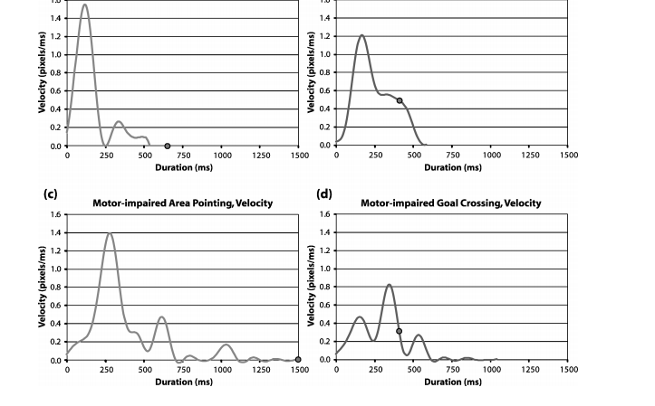
Domain matters: Min-jerk profile
Jacob O. Wobbrock and Krzysztof Z. Gajos. 2008. Goal Crossing with Mice and Trackballs for People with Motor Impairments: Performance, Submovements, and Design Directions. ACM Trans. Access. Comput. 1, 1, Article 4 (May 2008), 37 pages. DOI=10.1145/1361203.1361207 http://doi.acm.org/10.1145/1361203.1361207
Notes:
Fig. 17. Velocity proﬁles over time using the mouse for (a,b) able-bodied participants and (c,d)
motor-impaired participants. The dot represents the click or crossing event. The graphs on the
left are for area pointing. The graphs on the right are for goal crossing.

Slide 34
Value of Histograms
Helps you check: Do assumptions match your data?
Gives a sense of the distribution

Slide 35
Summary: Steps So Far
Question
Explore Data
Use data
Is it the right question?
Is it answerable?
Collect Data
Is it the right data for the question?
How hard/easy is it to collect?
Understand the fields
Clean Data
What flaws exist in the data?
Check and address the four Cs
Create subsets / views
Transform / delete variables
Visualize

Slide 36
Things we talked about
Transformations such as normalization, logs, and feature creation
Plots and their value
stem & leaf: flexible & quick
boxplot: supports comparison
Histogram: check a distribution
Distributions
Normal: Independent, Identically distributed random variables
Log Normal: Multiplied independent random vars (intuitively: one end is fixed, e.g. timings all > 0)
Poission: Constant rate of independent events
Notes:
relating distributions back to your understanding of the data

